Slide 1
Configuring Voice over Internet Protocol
(VoIP)
Prepared and presented by:
SUCHANDA MUKHERJEE

Slide 2
Introduction to VoIP
VoIP is an acronym for Voice Over Internet Protocol
Also referred to as “IP Telephony or Internet Telephony”
It is an alternative to using landlines that are actually cheaper in cost, which is why most businesses are switching over to VoIP
VoIP can be adopted for HOME use, Work or for a corporate network.

Slide 3
Overview
VoIP is a Layer 3 network protocol that uses various Layer 2 point-to-point or link-layer protocols such as PPP, Frame Relay, or ATM for its transport.
VoIP enables Cisco routers, access servers, and multiservice access concentrators to carry and send voice and fax traffic over an IP network.
In VoIP, digital signal processors (DSPs) segment the voice signal into frames and store them in voice packets.
These voice packets are transported via IP in compliance with a voice communications protocol or standard such as H.323, Media Gateway Control Protocol (MGCP), or Session Initiation Protocol (SIP).

Slide 4
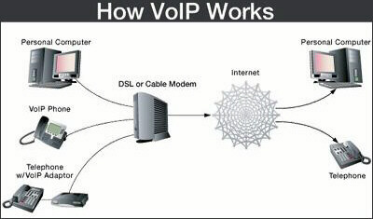
How VoIP Works
VoIP transmits the sound over a
standard internet infrastructure
using the IP Protocol,DHCP plays a
significant role in connecting the
calls made.

Slide 5
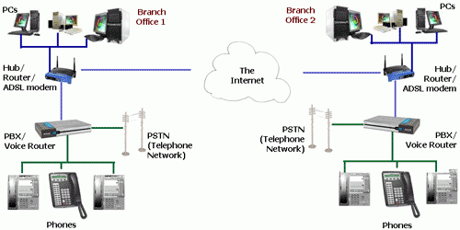
Example: A VoIP Network

Slide 6
DHCP’s Role for VoIP
DHCP (Dynamic Host Configuration Protocol) is the protocol used to find an IP address.
DHCP protocol is used when a host comes alive in the network for the first time.
It allows the computer to join an IP-Based network without having a pre-configured IP address.
The host broadcasts a request message in the network, along with its MAC address.
The DHCP replies back with a unicast message and assigns the host an unique IP address.
IP address is allocated for some particular time frame.
After use, the server releases and renews these addresses as devices leave and join another network.

Slide 7
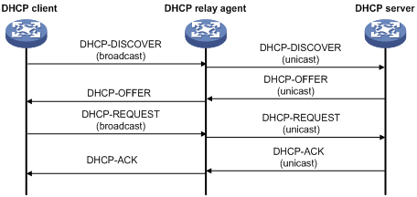
How DHCP works

Slide 8
Circuit Elements
Cisco 2811 Routers, because it is the only router with IP Telephony Services
Cisco 2960 Switch, used to connect routers with the elements of network.
IP Phones
Analog Phone
PCs
Laptops
Fast Ethernet Connections (between routers and switches, switches and end devices)
Serial Connections (between two routers)

Slide 9
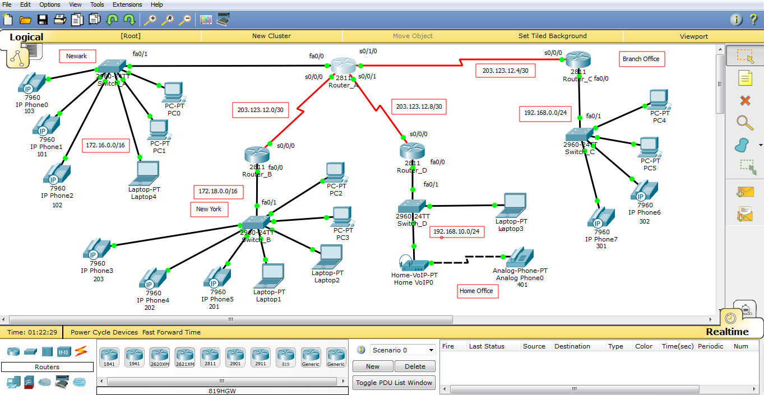
Screenshots

Slide 10
Connection Steps
Powering on the IP phones
Configuring the Switches
Configuring the Routers
Configuring DHCP server
Configuring Call Manager Express (CME)
Configuring the Routing Protocol
Configuring connections between locations

Slide 11
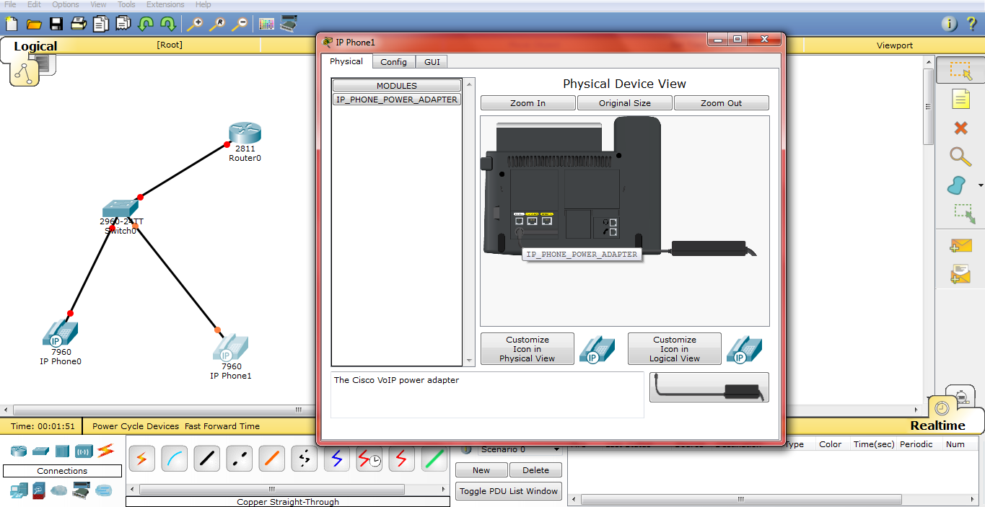
Powering on the IP phone:

Slide 12
Configuring Cisco Switch 2960
IP phones need to be added to their own VLANs
The switches are configured through CLI, using the following commands sequentially:
enable | (enable the router)
configure terminal | (enter configuration mode)
hostname Switch_A | (set the name of the switch to Switch_A)
interface range f0/1-10 | (configures all interfaces in the range of 1 to 10)
switchport mode access | (sets interface as a nontrunking, nontagged single VLAN Ethernet interface)
switchport voice vlan 1 | (instructs IP phone to forward all voice traffic through the specified VLAN)
exit | (exit from the interface configuration and return to configuration mode)

Slide 13
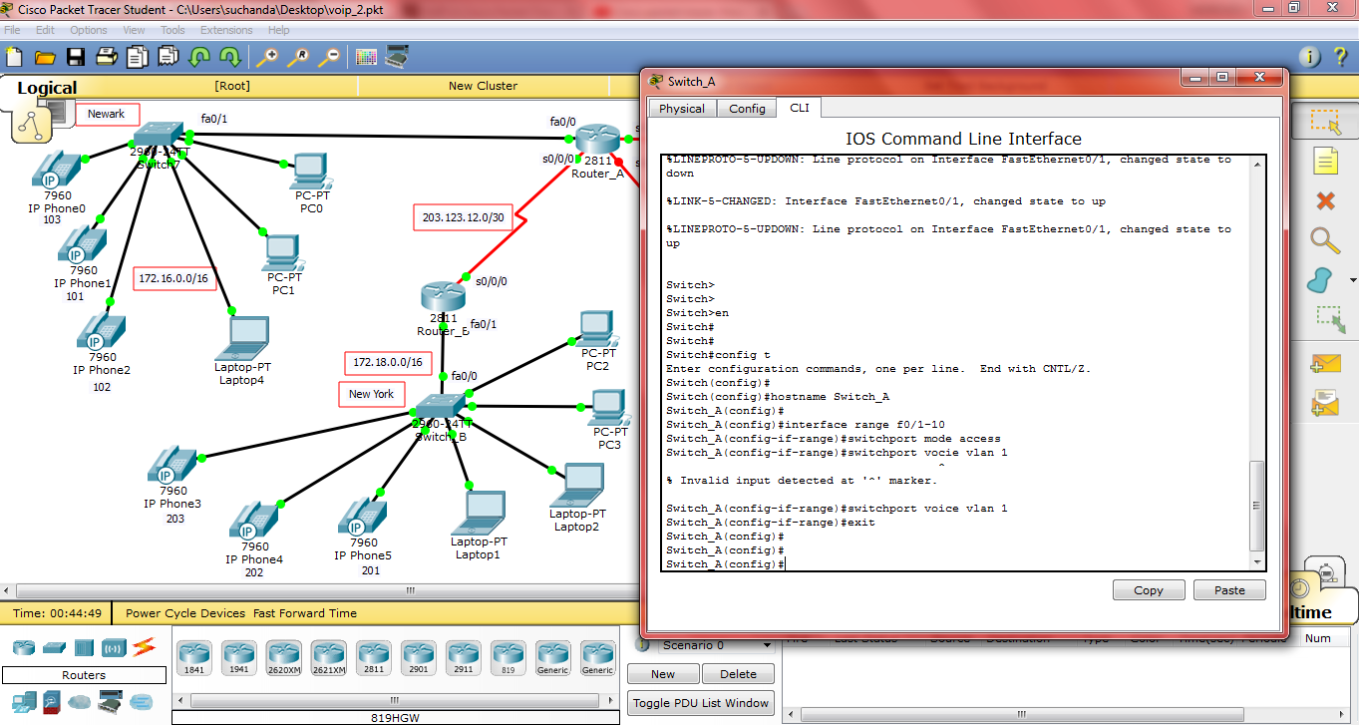
Configuring Cisco Switch 2960

Slide 14
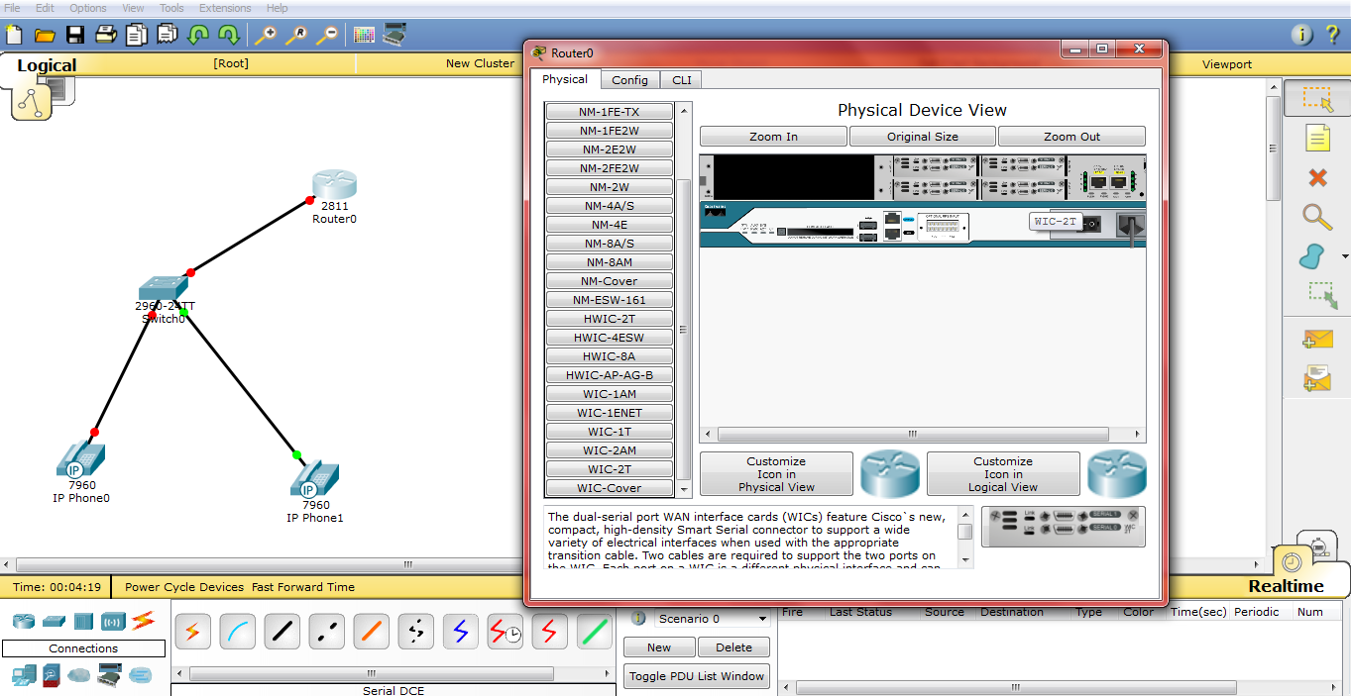
Serial Port in Cisco Router-2811

Slide 15
Configuring Cisco Router-2811
Enabling the WIC-2T terminal for serial communication, for DTE/DCE connections.
The routers are configured through CLI, using the following commands sequentially:
enable | (enable the router)
configure terminal | (enter configuration mode)
hostname Router_A | (set the name of the router to Router_A)
interface fastethernet 0/0 | (enter interface configuration mode, configures the link with Switch_A)
description Link to Switch_A | (description of the previous command)
no shutdown | (makes the link between the router and switch to stay up)
ip address 172.16.0.1 255.255.0.0 | (assigns IP address to Router_A along with subnet mask)
exit | (exit from the interface configuration and return to configuration mode)

Slide 16
Configuring DHCP Server
The routers need to be set as DHCP servers for the VoIP services
DHCP server is configured using the following commands sequentially:
ip dhcp pool PHONE | (name DHCP server address pool and enters DHCP pool configuration mode)
network 172.16.0.0 255.255.0.0 | (subnet address and mask for DHCP address pool)
default-router 172.16.0.1 | (specifies IP address of a default router for DHCP client)
option 150 ip 172.16.0.1 | (provides IP address for a list of TFTP servers, needed for configuring IP phones)
exit | (exit DHCP pool configuration mode)

Slide 17
Configuring Call Manager Express
Call Manager Express (CME) is needed for the telephony services that run on the routers.
CME is configured through routers.
CME is configured using the following commands sequentially:
telephony-service | (initiates CME service on the router)
max-ephones 5 | (maximum number of IP Phone supported by CME)
max-dn 5 | (maximum number of extensions or directories supported by CME)
ip source-address 172.16.0.1 port 2000 | (router receives messages through TCP port 2000 on given address)
auto assign 4 to 6 | (automatically assigns buttons on the IP phones to the line)
auto assign 1 to 5

Slide 18
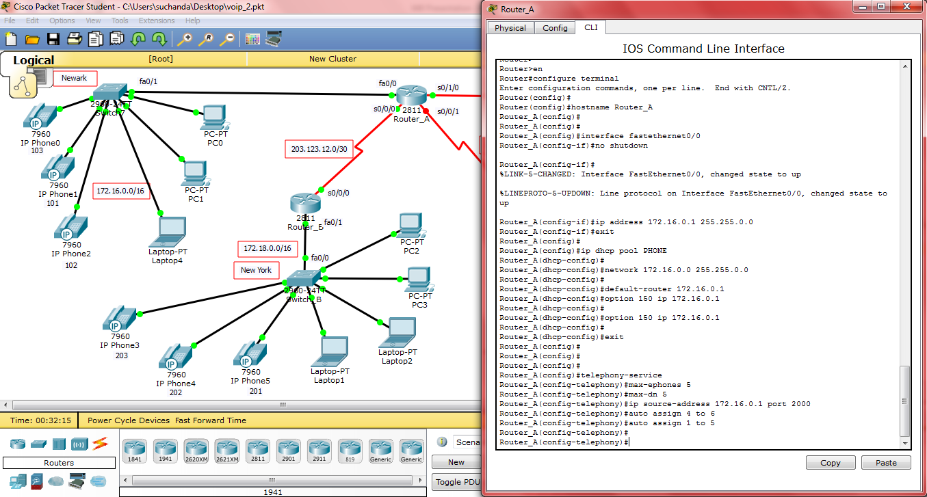
Configuring Cisco Router 2811

Slide 19
Assigning Phone Numbers
Phone numbers are assigned to IP phones using the following commands sequentially:
ephone-dn 1 | (assigns telephone numbers to IP phones connected to a network for understanding and easy identification purpose. The number registered for a phone in this step is the number dialed to ring the phone)
number 101
exit
ephone-dn 2
number 102
exit
ephone-dn 3
number 103
exit

Slide 20
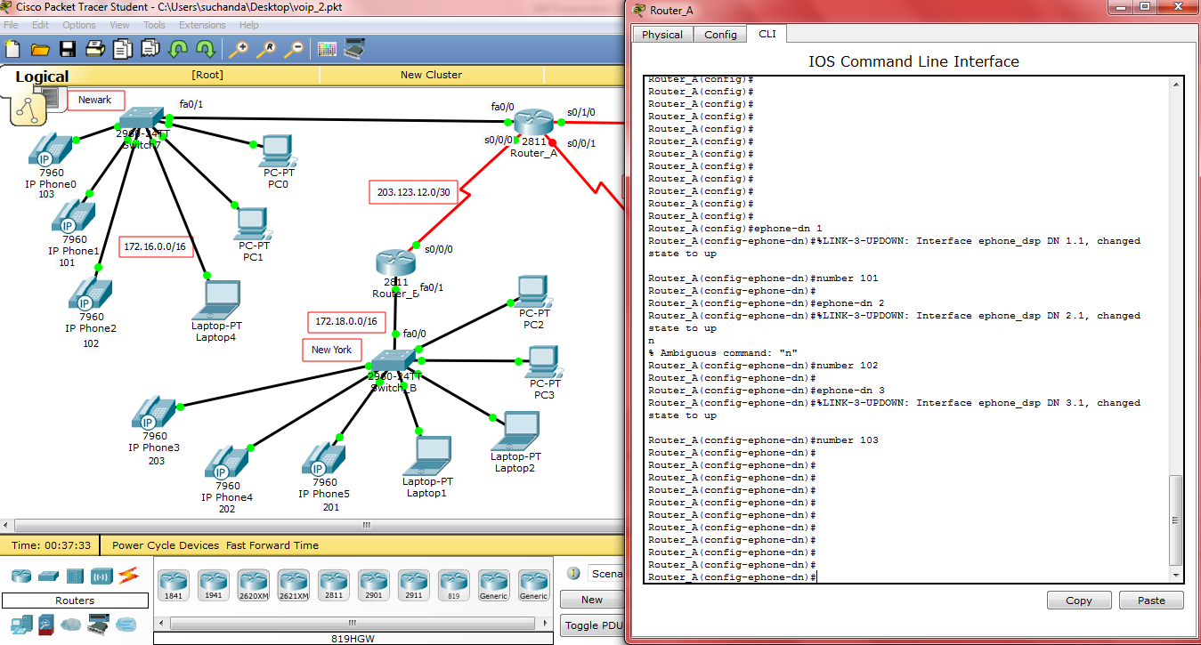
Assigning Phone Numbers

Slide 21
EIGRP
Advanced distance-vector routing protocol designed by Cisco Systems.
Sends incremental updates, reducing workload on the router involved.
Dynamic protocol where routers automatically share route information.
Router involved maintains two other tables apart from Routing Table.
Neighbor Table : Keeps information about all the routers which are physically connected to this router.
Topology Table : Stores routes that it has learned from neighbor routing tables.
Supports Classless Inter-Domain Routing (CIDR) and variable length subnet masking .
Supports load balancing in parallel link between sites.
MD5 authentication between two routers.
Backward compatibility with IGRP routing protocols.
Send differential changes rather than the whole routing table.

Slide 22
Routing Protocol
Routing protocol is needed for communication between two routers.
Enhanced Interior Gateway Routing Protocol (EIGRP) is used.
Routing protocol is configured using the following commands sequentially:
enable | (enable router)
configure terminal | (enter configuration mode)
interface serial 0/0/0 | (configure serial interface with Router_B)
description Link to Router_B | (description of the previous command)
ip address 203.123.12.1 255.255.255.252 | (sets IP address of the link with subnet mask)
clock rate 64000 | (sets clock rate serial DCE/DTE connection)

Slide 23
Routing Protocol (Contd.)
no shutdown | (restarts a disabled interface)
exit | (exit from interface configuration mode and return to configuration mode)
router eigrp 1 | (disables auto-summary for EIGRP process 1)
no auto-summary
network 172.16.0.0 | (routing between the given networks)
network 203.123.12.0
exit | (exit the configuration mode)

Slide 24
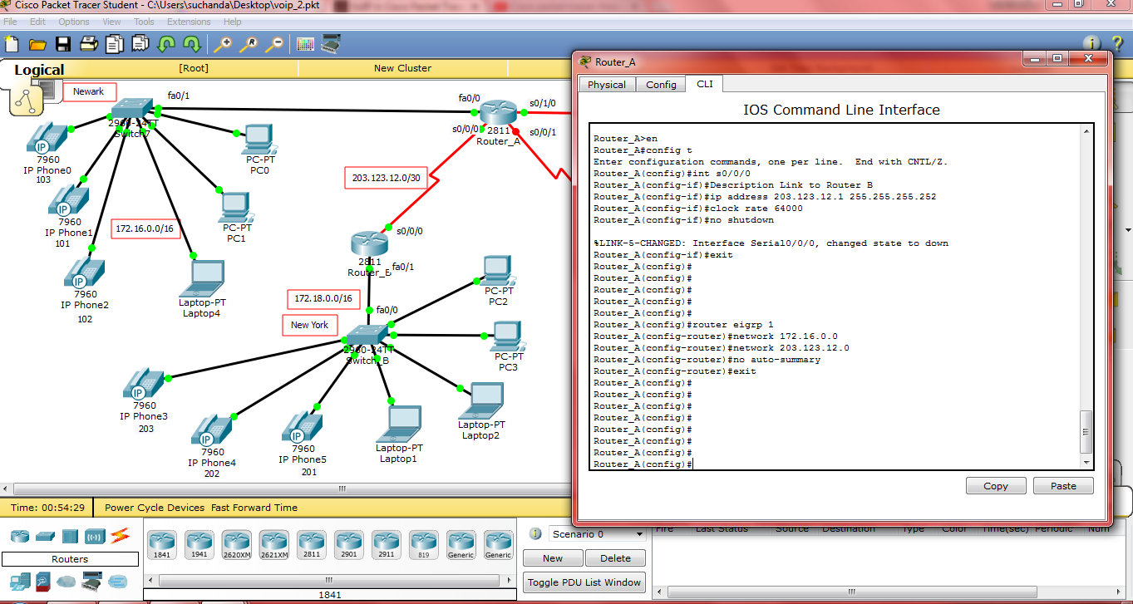
Routing Protocol

Slide 25
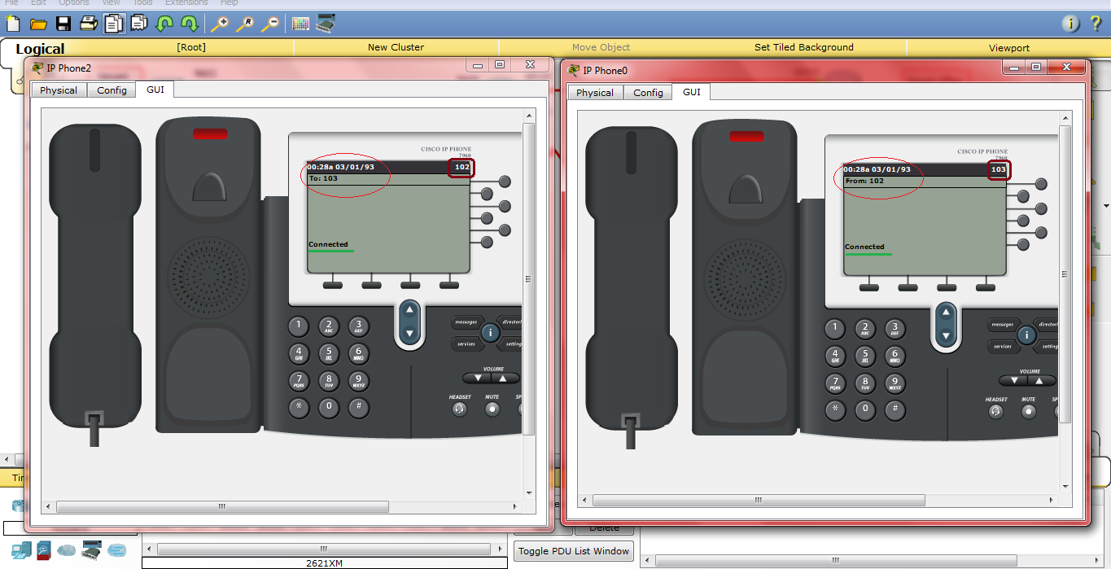
Calls inside a Network (102 calling 103)

Slide 26
Connection between Locations
Routers need to be configured for calls across the network
Routers are configured using the following commands sequentially:
dial-peer voice 1 voip | (the router looks for outbound dial peer. As soon as it receives some number starting with 3, the router matches it with dial-peer 10 and routes the call accordingly)
destination-pattern 2..
session-target ipv4: 203.123.12.2
exit
dial-peer voice 10 voip
destination-pattern 3..
session-target ipv4:203.123.12.6
exit

Slide 27
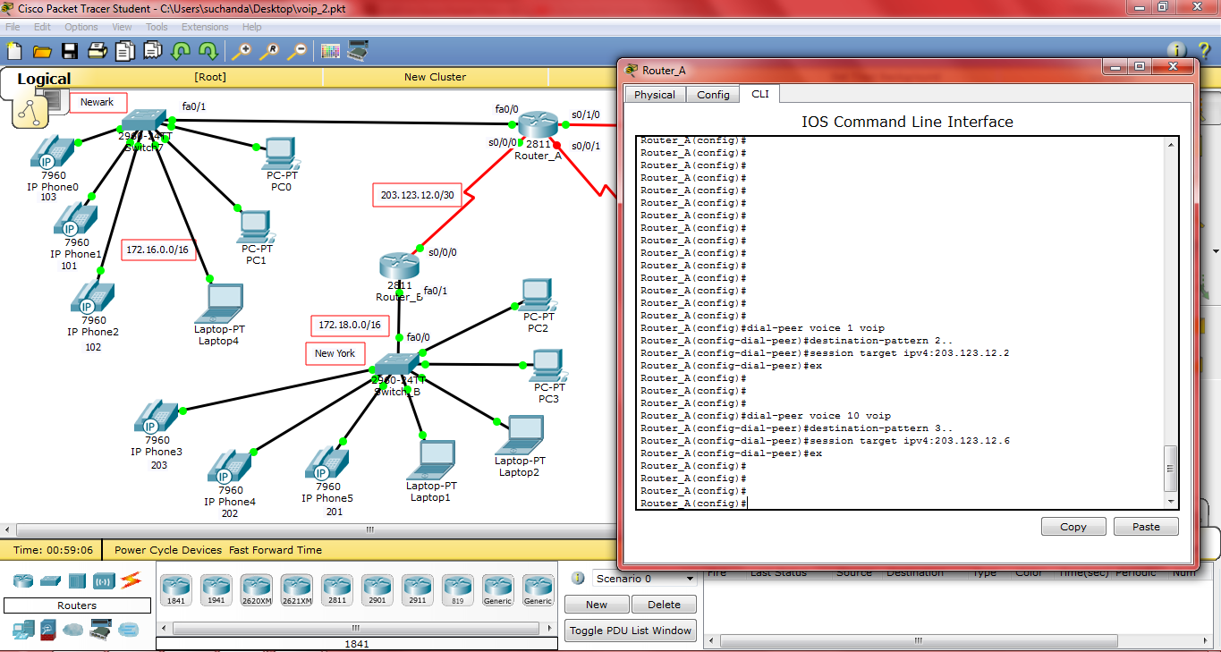
Connection between Locations

Slide 28
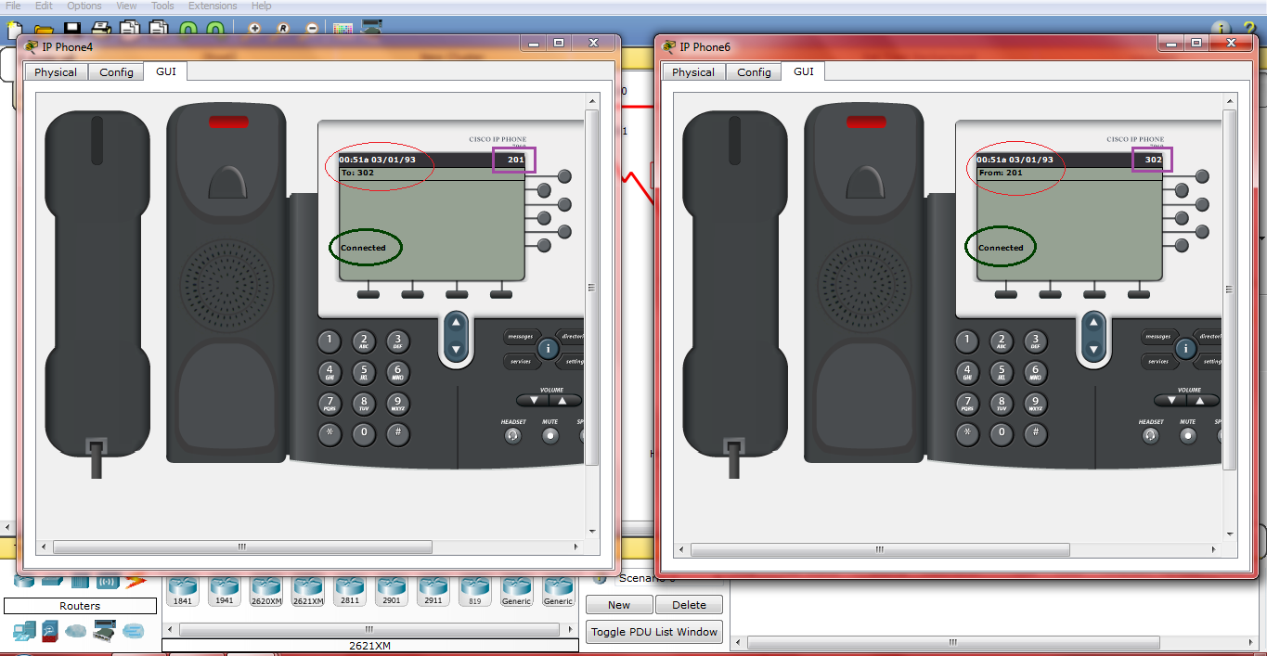
Calls between Networks (201 calling 302)

Slide 29
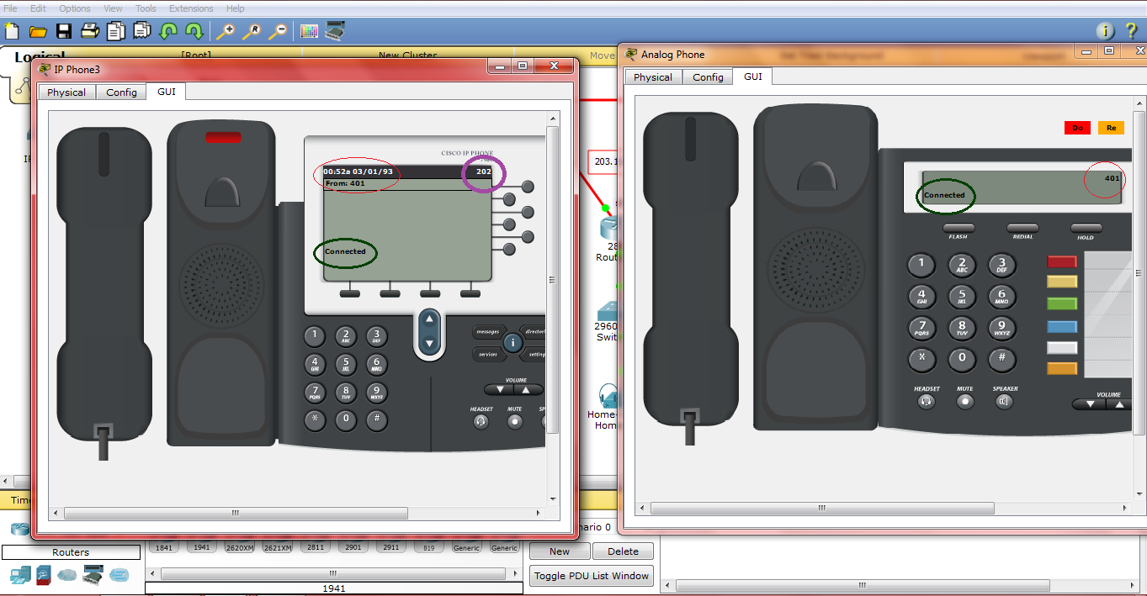
Analog to IP Phone(401 calling 202)

Slide 30
References
http://voip.about.com/od/voipbasics/a/whatisvoip.htm
http://compnetworking.about.com/cs/protocolsdhcp/g/bldef_dhcp.htm
http://pixshark.com/cisco-voip-diagram.htm
http://www.cisco.com/c/en/us/td/docs/ios/12_2/voice/configuration/guide/fvvfax_c/vvfvoip.pdf
http://www.unixmen.com/installing-cisco-packet-tracer-linux/
http://www.cisco.com/c/en/us/td/docs/security/asa/asa84/configuration/guide/asa_84_cli_config/basic_dhcp.html
http://en.wikipedia.org/wiki/Dynamic_Host_Configuration_Protocol
http://www.packettracernetwork.com/tutorials/voipconfiguration.html

Slide 31
References
http://www.h3c.com/portal/Products___Solutions/Technology/IPv4___IPv6_Services/Technology_White_Paper/200804/602779_57_0.htm
http://www.cornerstonebs.co.uk/solutions/voip-network-diagram
http://en.wikipedia.org/wiki/Enhanced_Interior_Gateway_Routing_Protocol
http://www.highteck.net/EN/Cabling/Planning_and_Cabling_Networks.html

